Slide 1



Slide 2
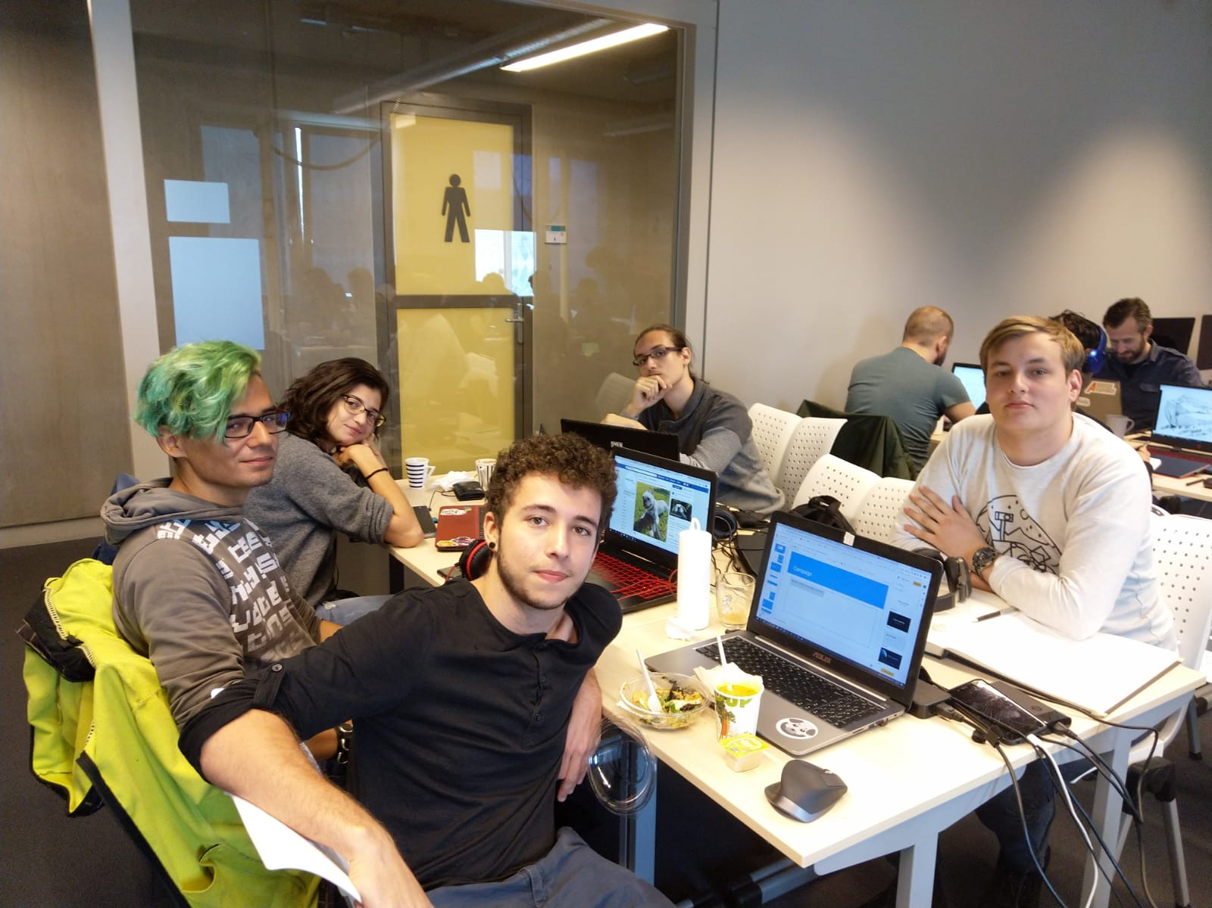
Team
Designer
Mihai Niculescu
Engineer
Arjen ‘Big Brain’ de Aldrey
Artists
Victor Start
Viktoria Minkova
Valentin Georgiev

Slide 3
Scrum planning

Slide 4
Researching concepts and Fleshing out designs.
Polishing game and Produce marketing items.
Week 1
Week 2
Week 3
Testing concept and Producing game.

Slide 5
Campaign
The Shelter Pet Project
“Our goal is to make shelters the first place potential adopters turn when looking to get a new pet, ensuring that all healthy and treatable pets find loving homes. We do this by breaking down misconceptions surrounding shelter pets and celebrating the unique bond between every shelter pet and parent.”

Slide 6
Research
Define goals
Extract components
Conduct study
Interview shelter

Slide 7
Empathy map

Slide 8
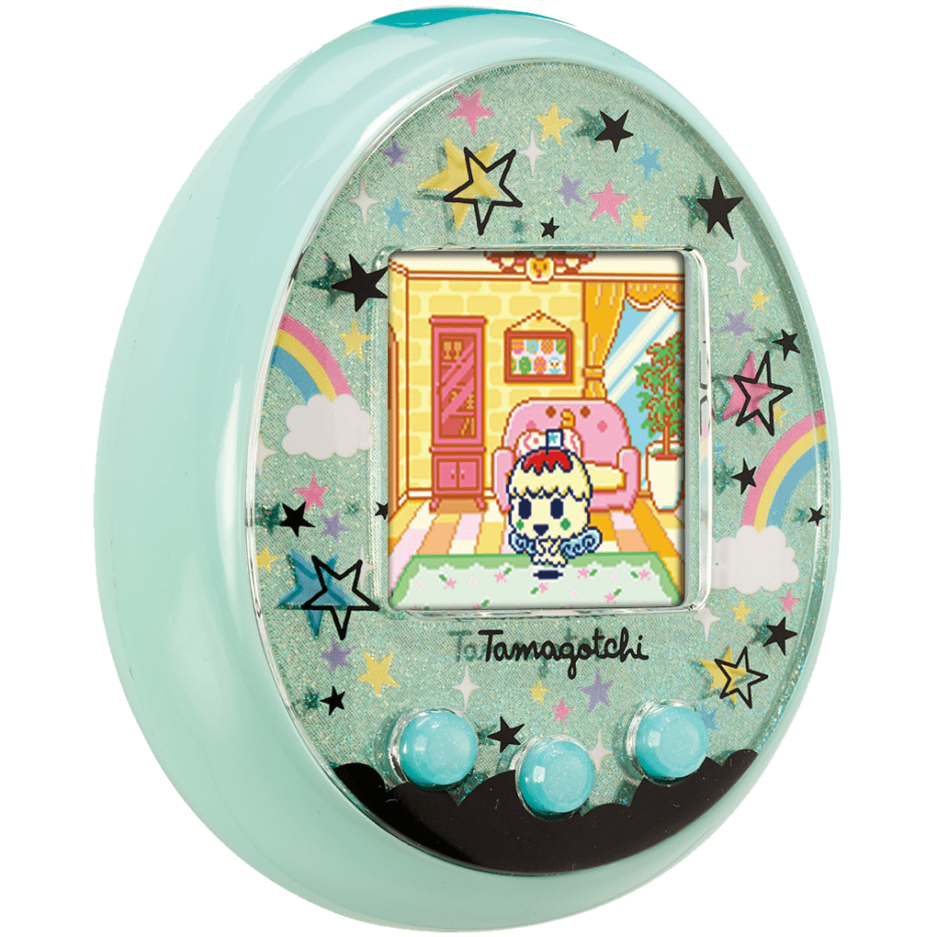

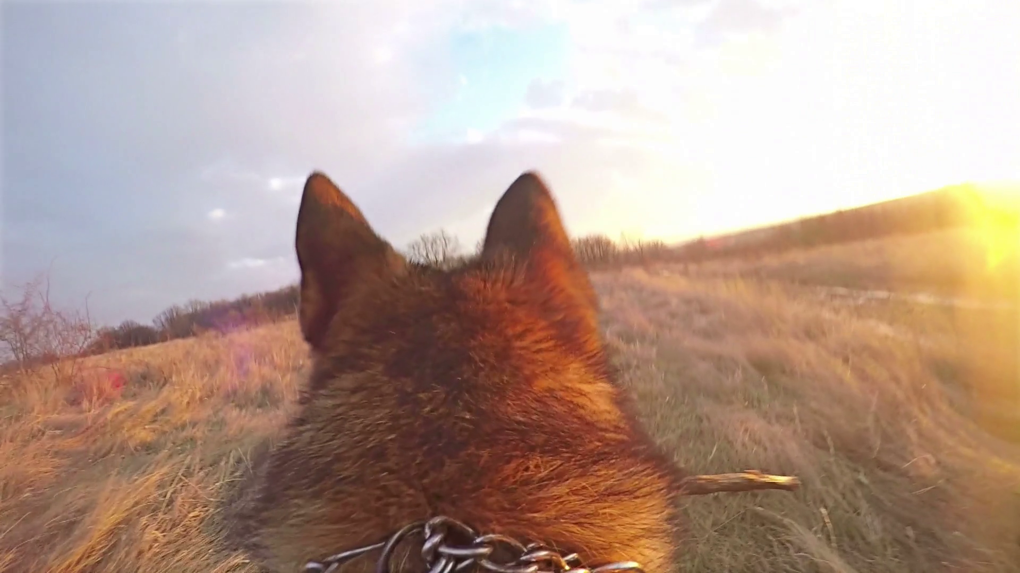
Tamagotchi
Dog Catcher
Concepts
Dog POV

Slide 9
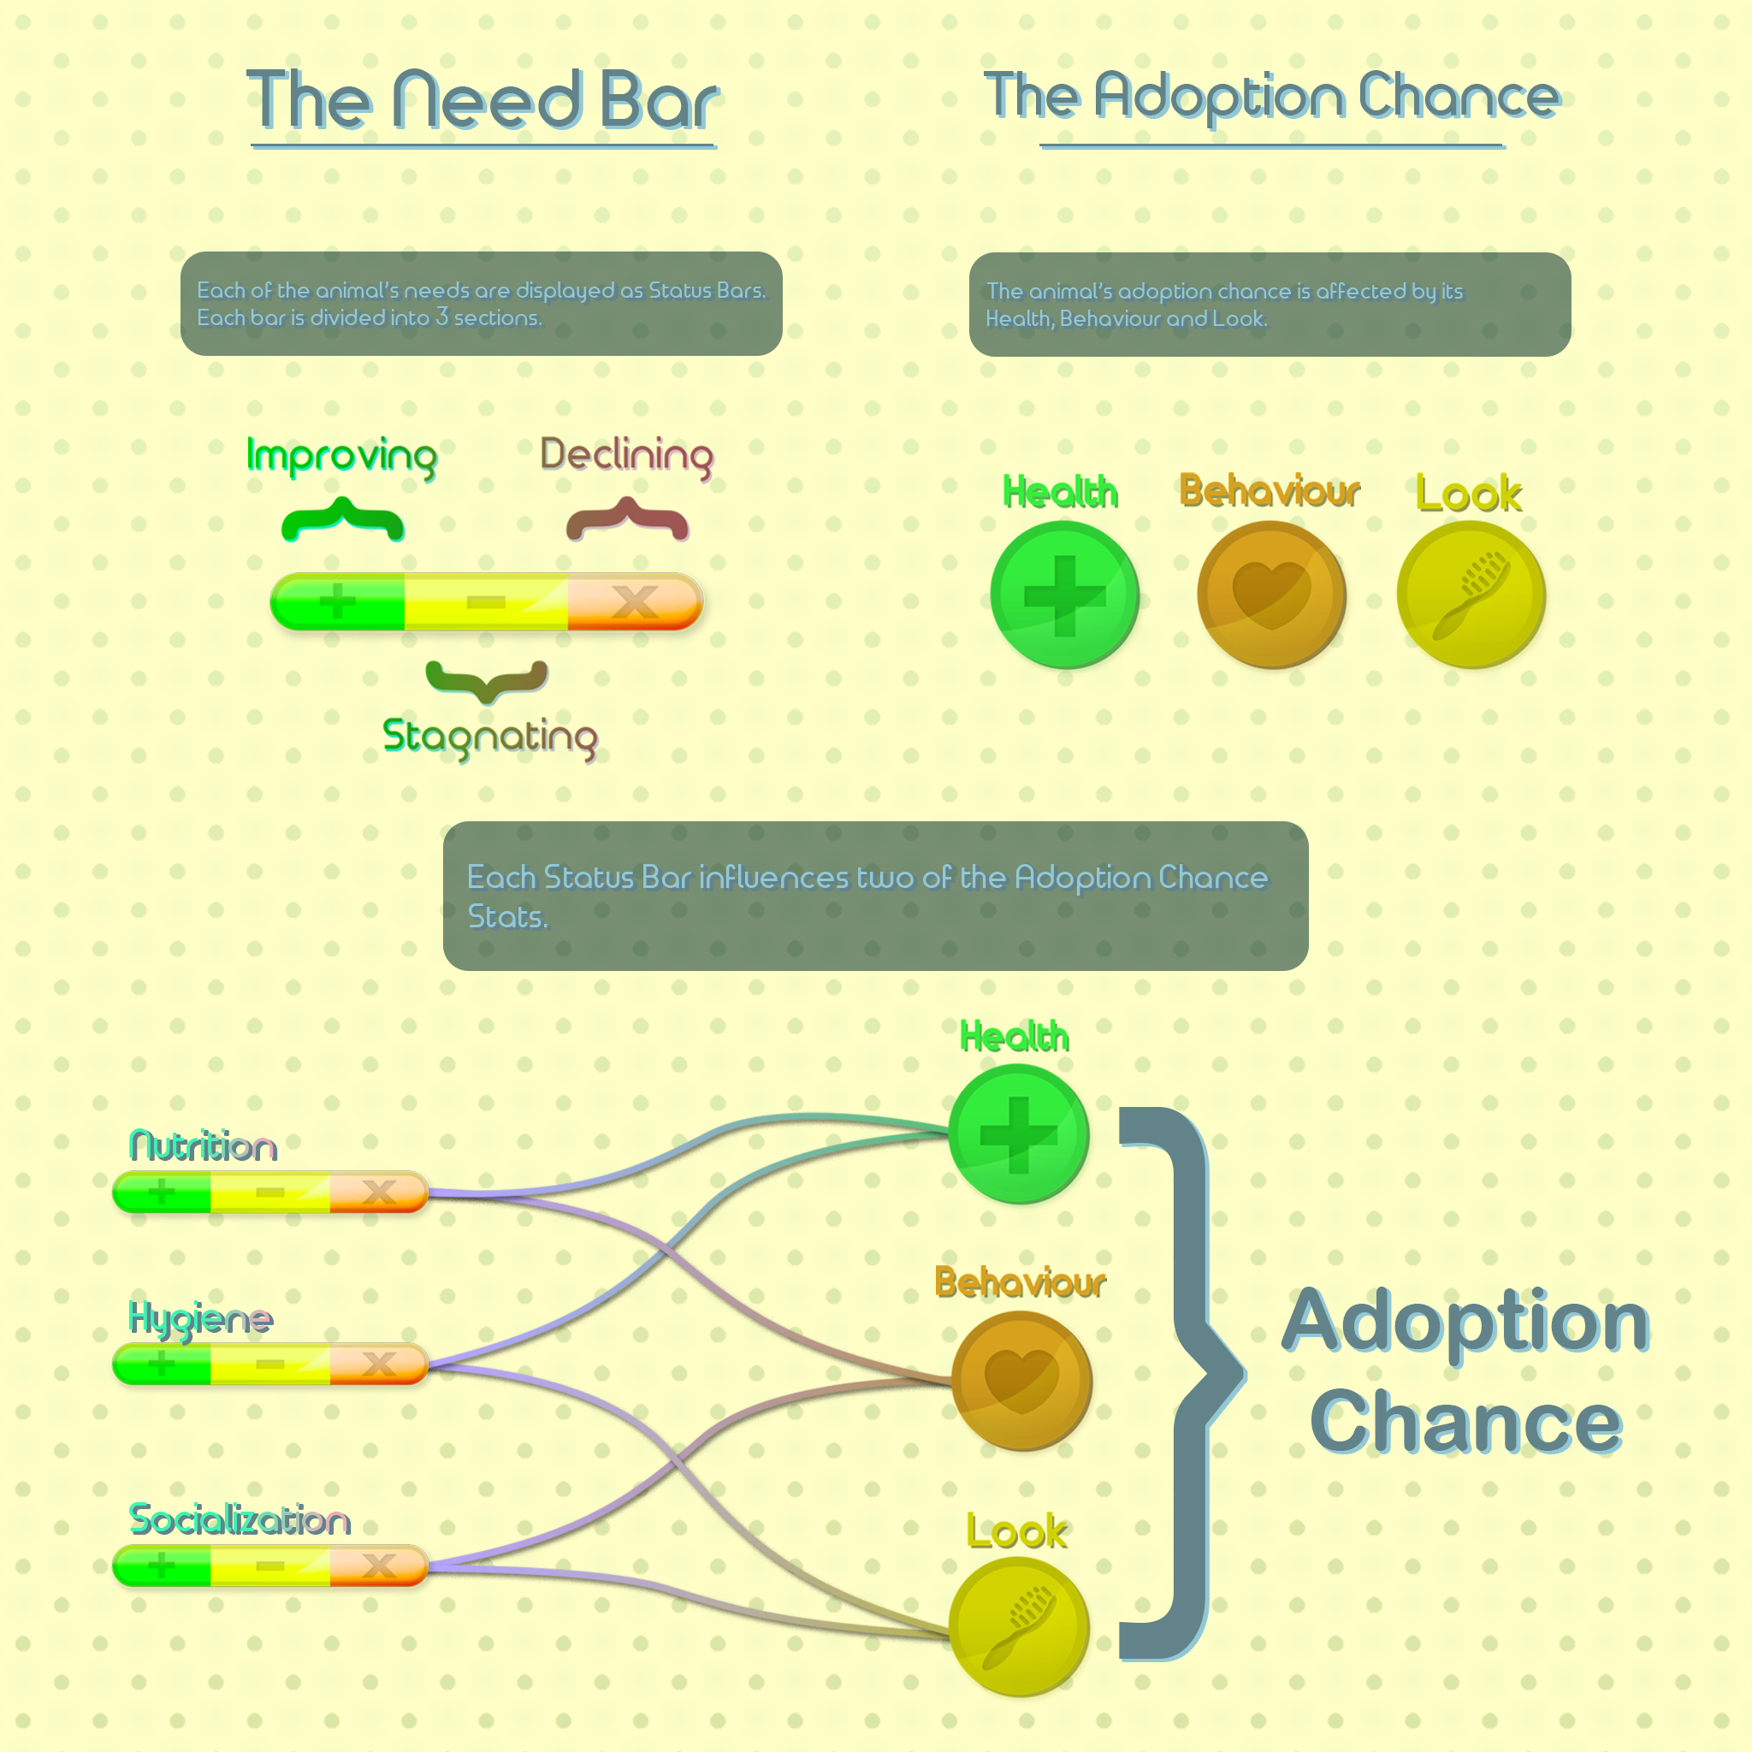
Game Rules

Slide 10
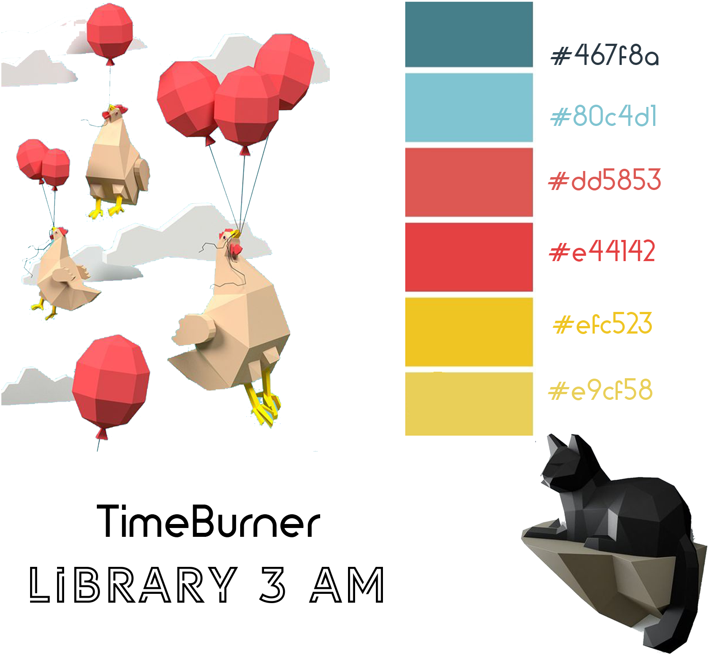
Style-sheet

Slide 11
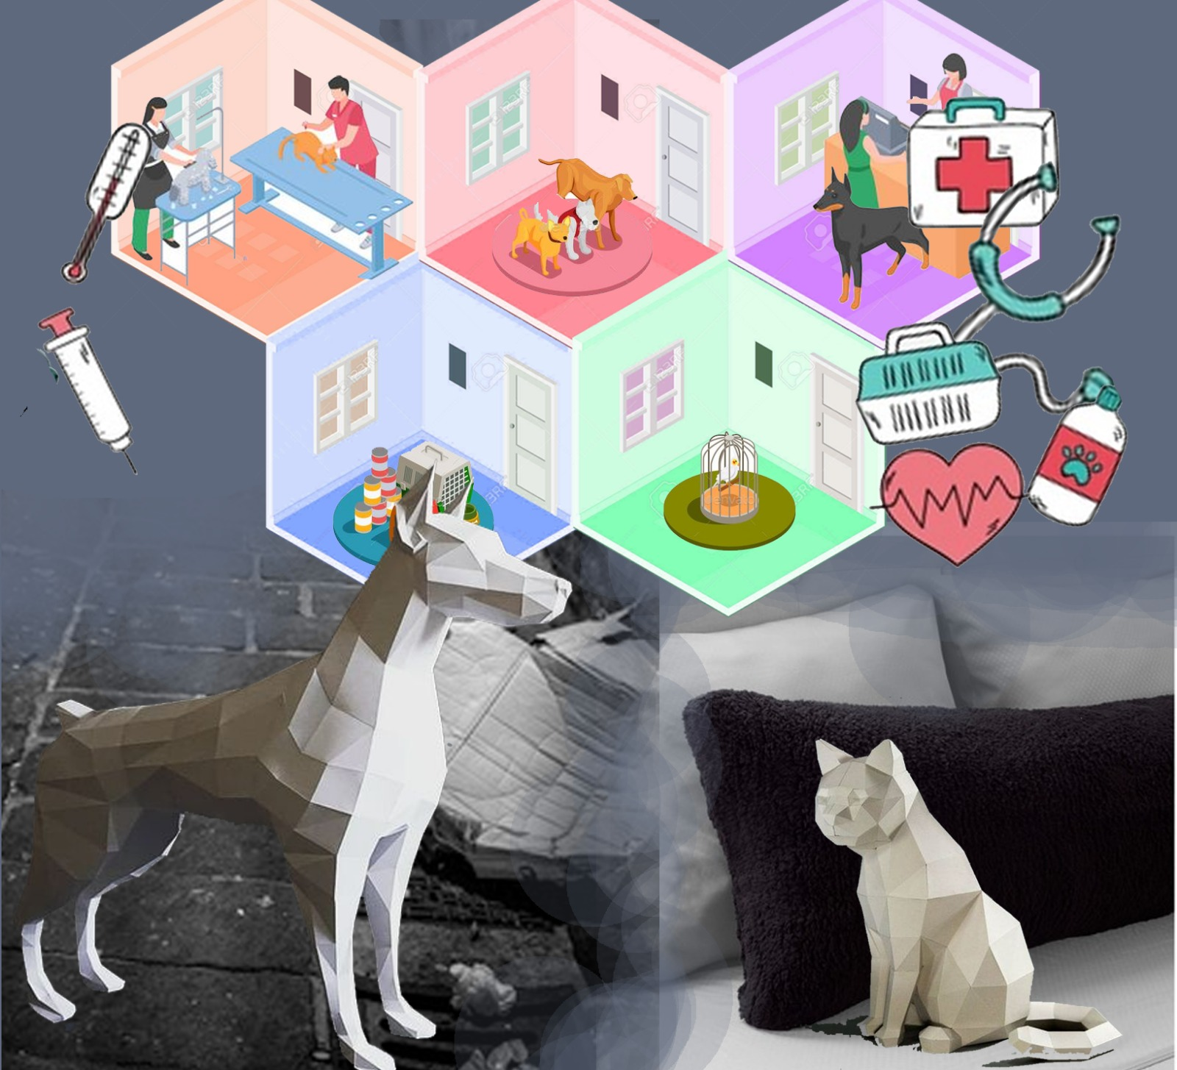
Moodboard

Slide 12
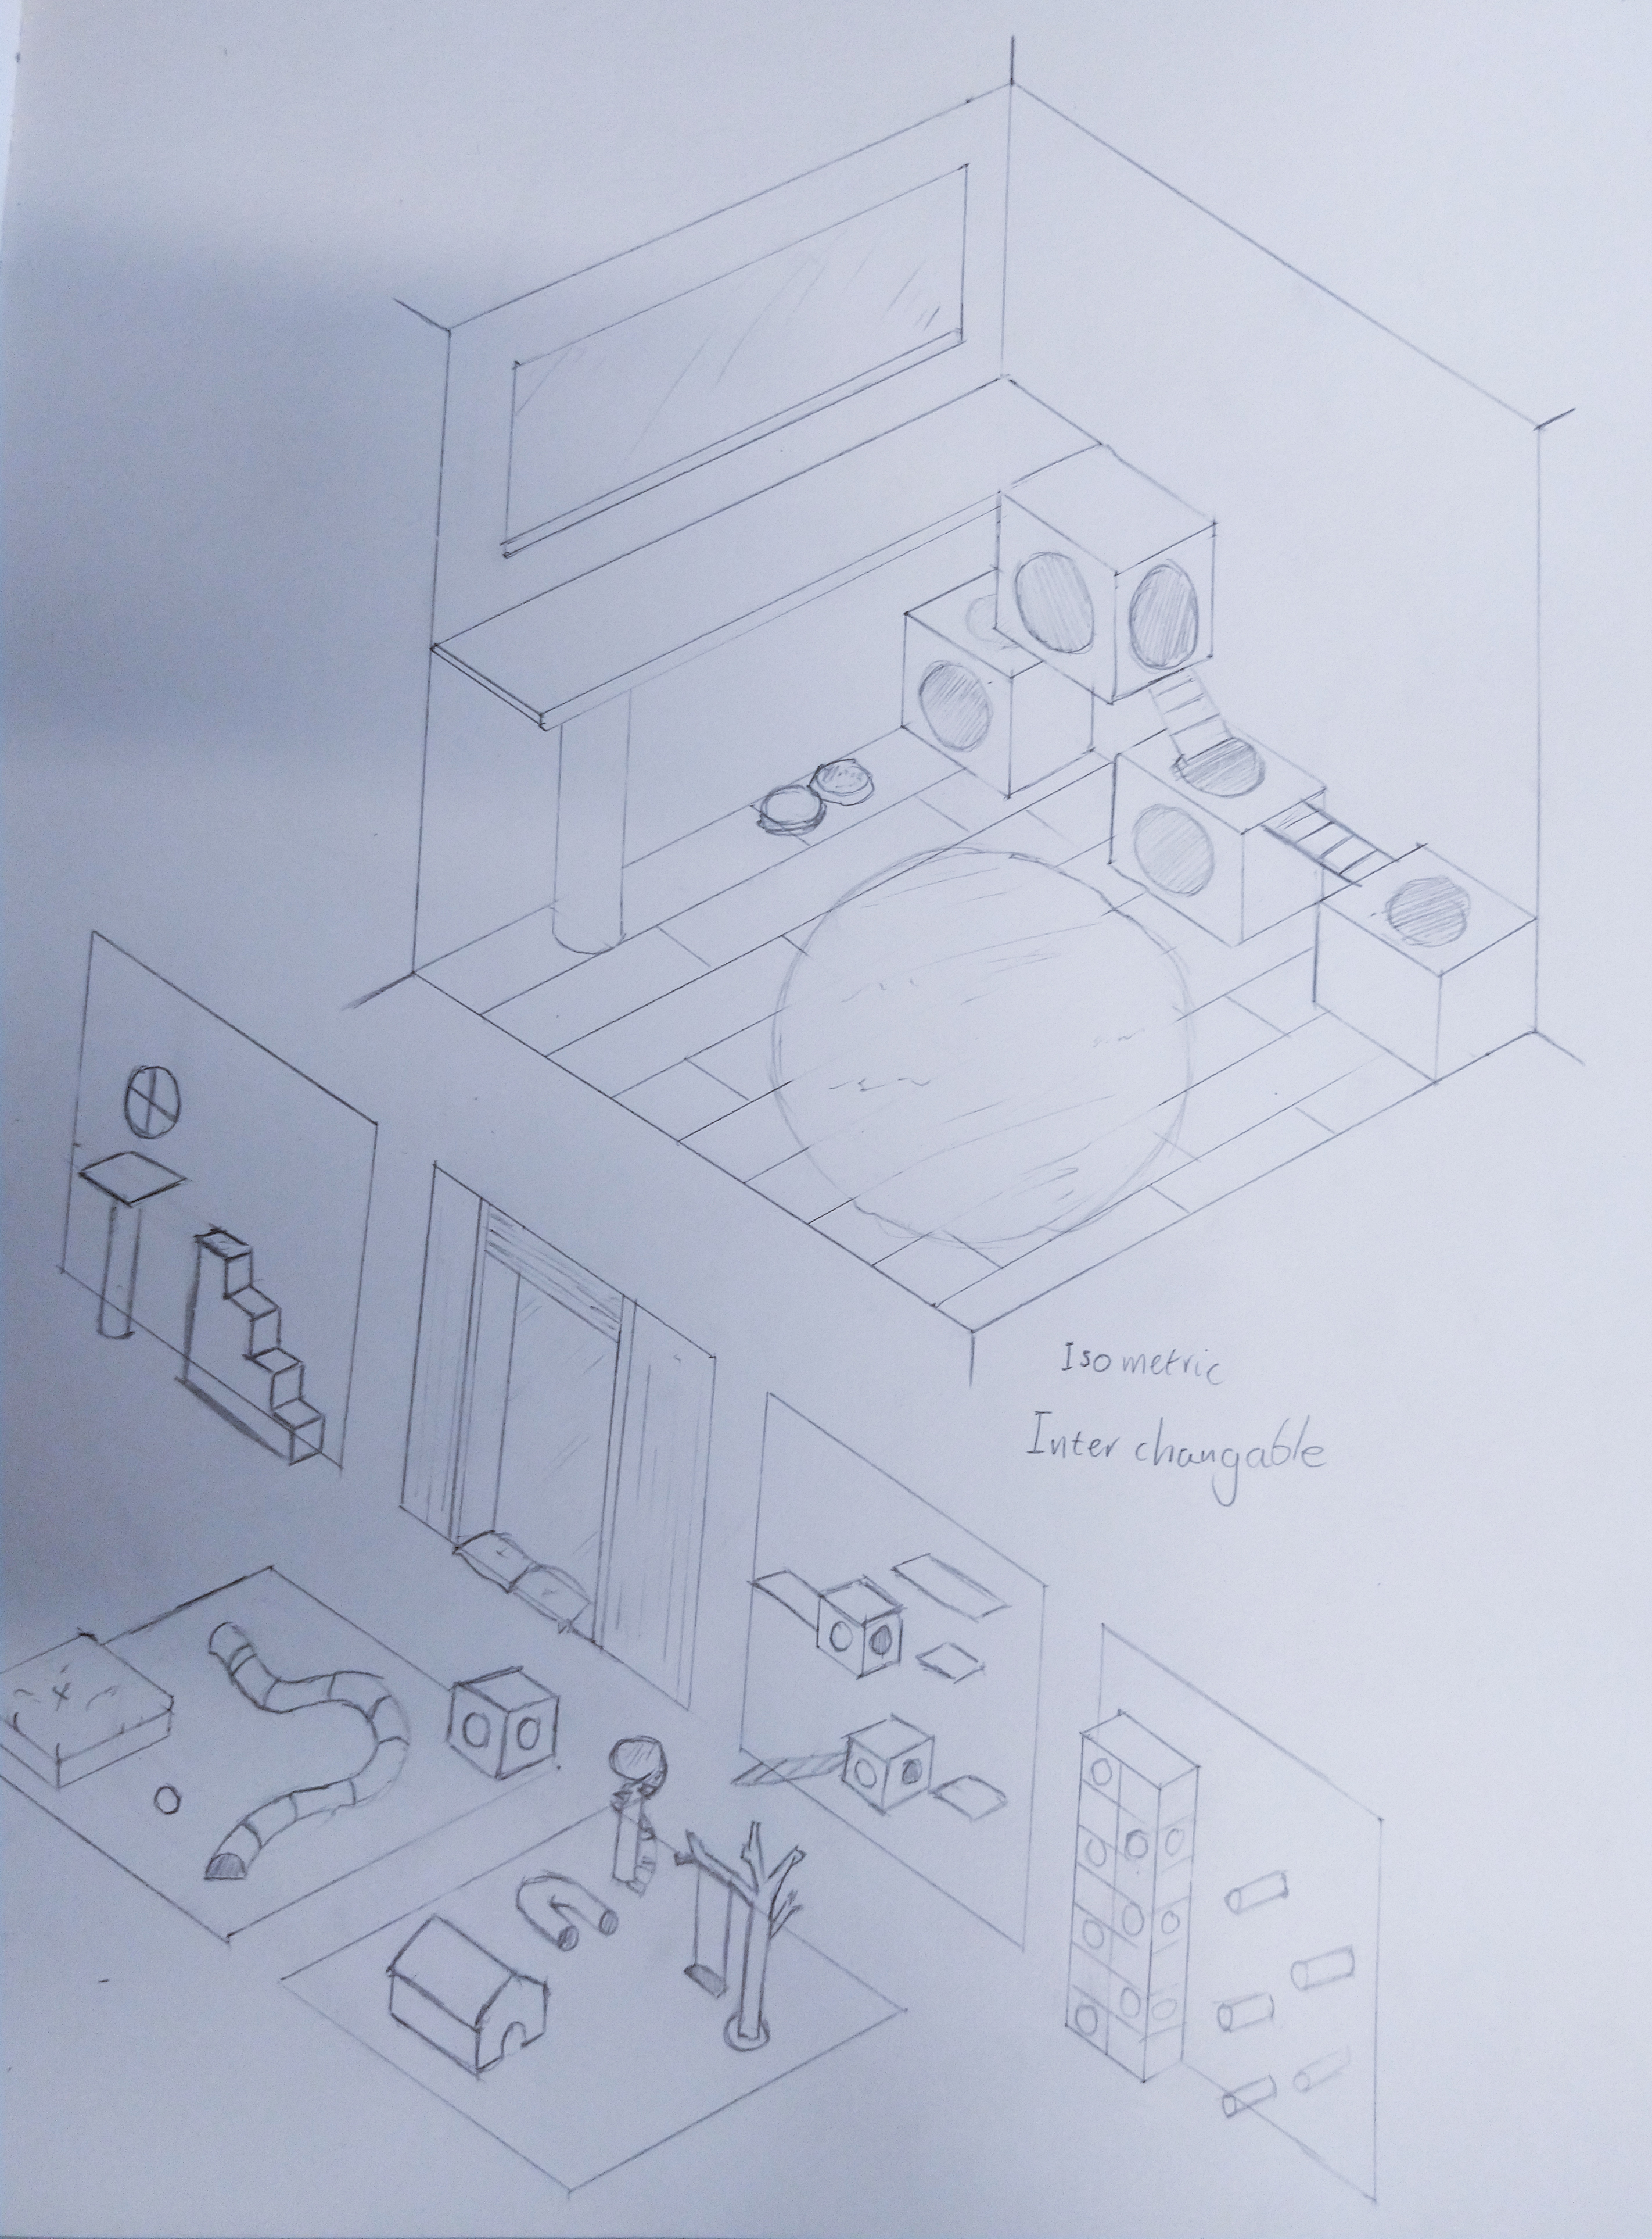
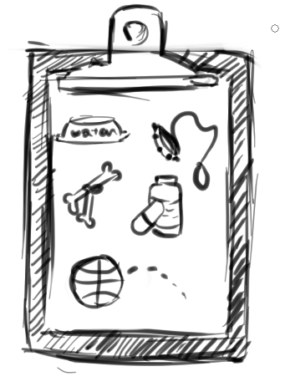
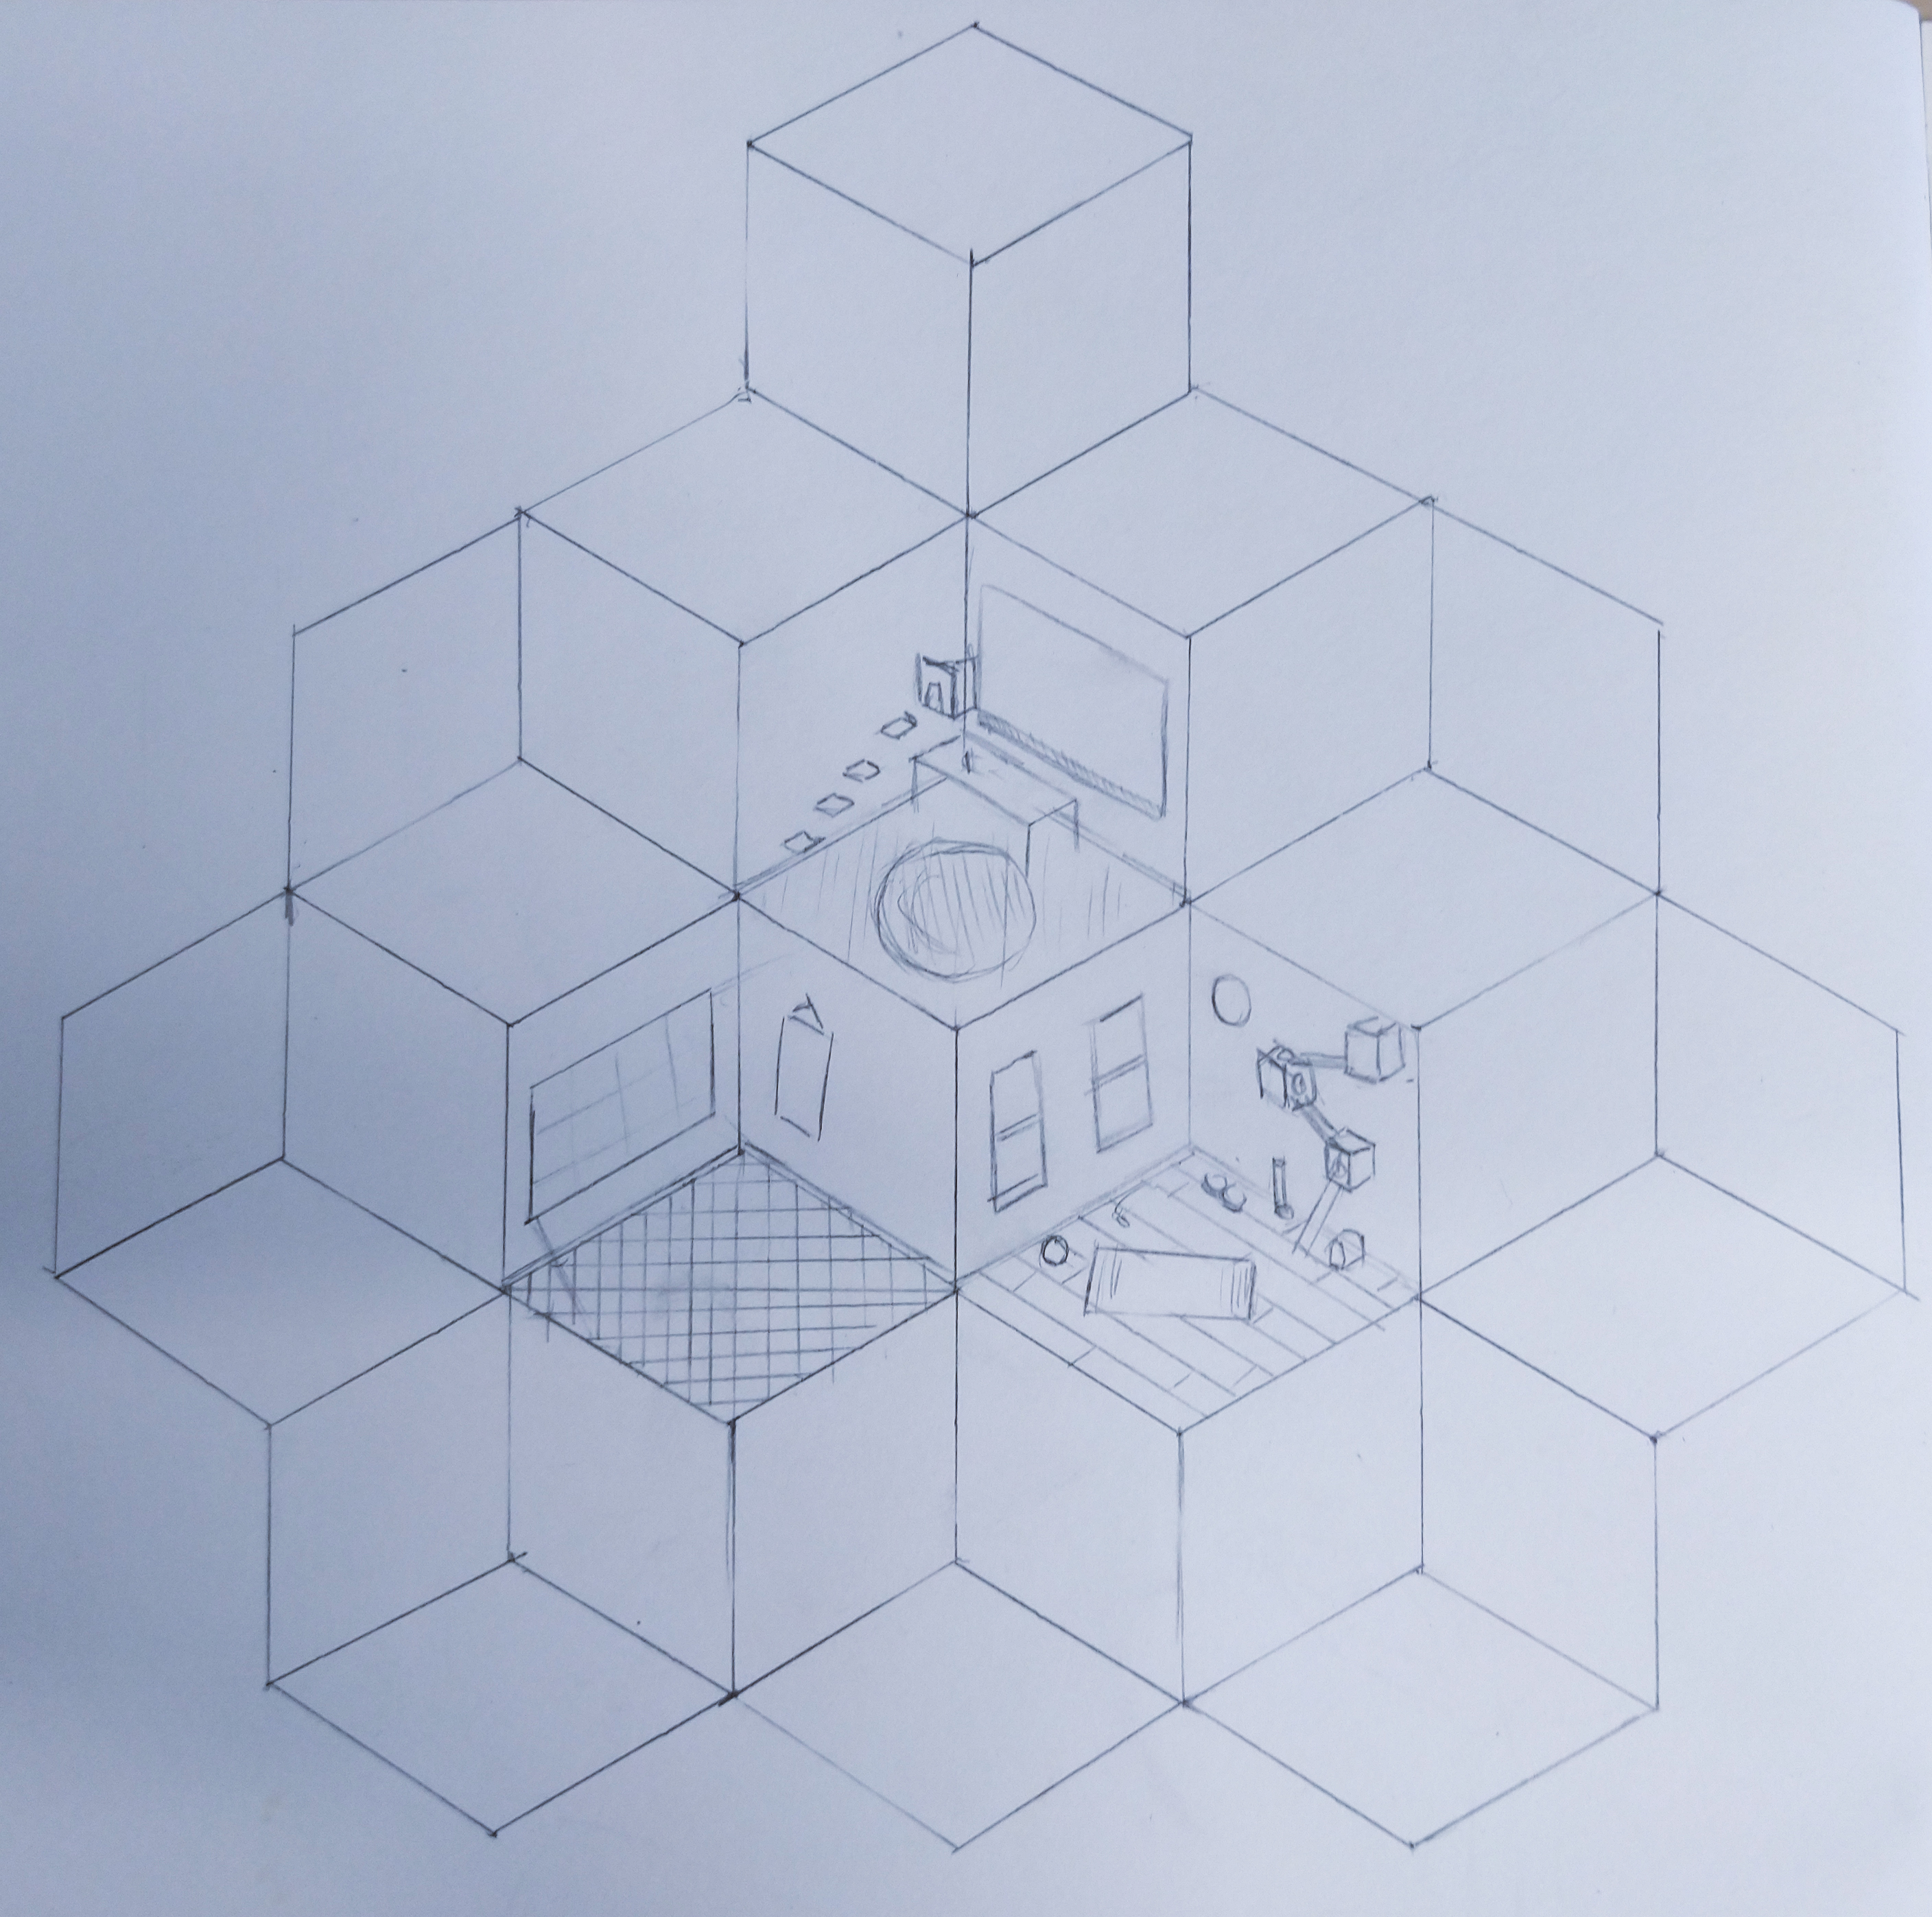
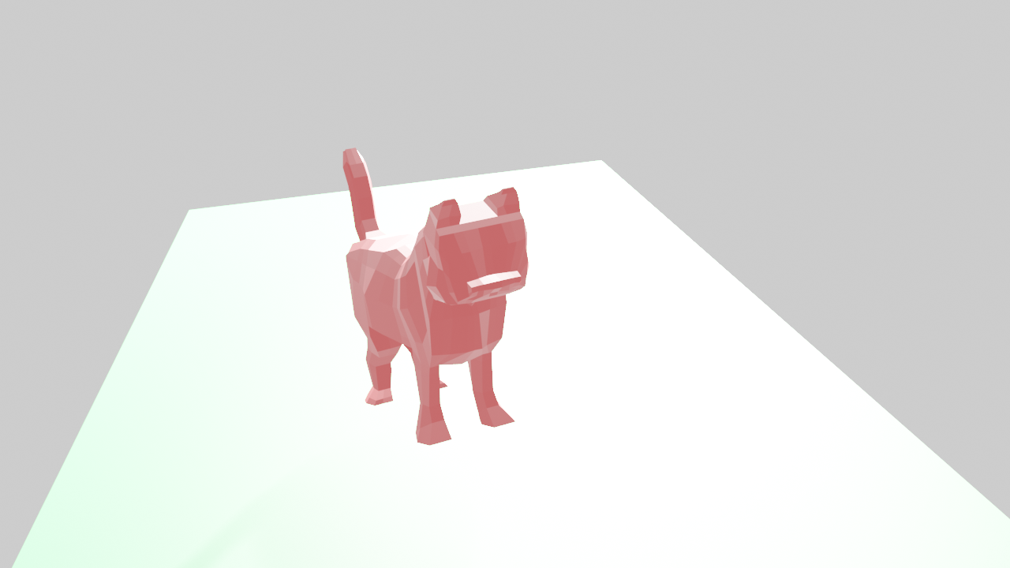
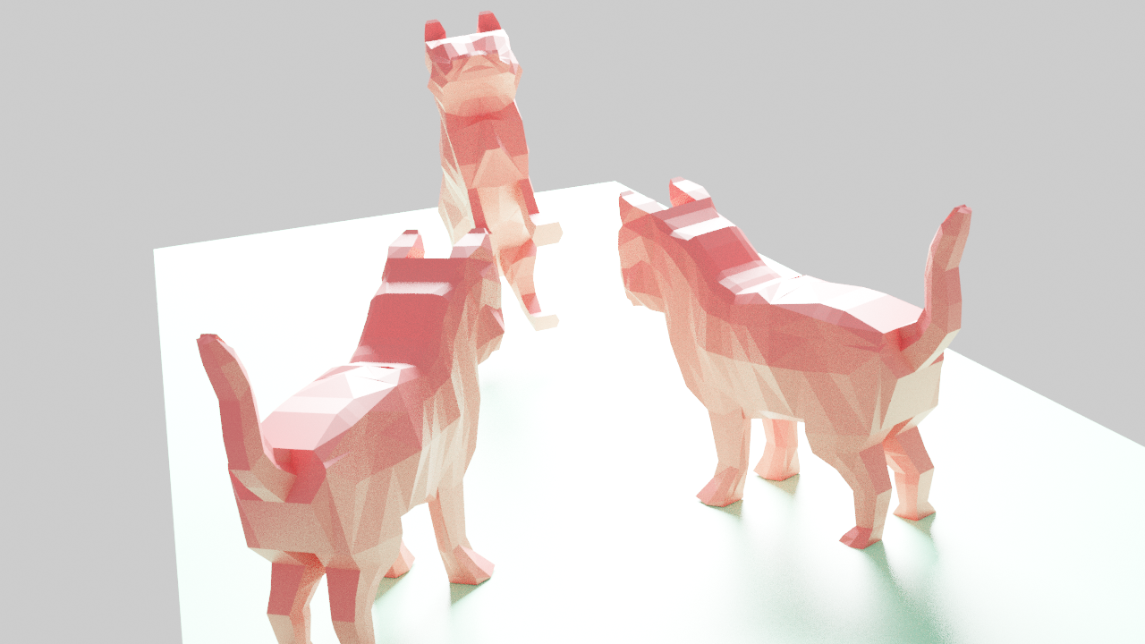
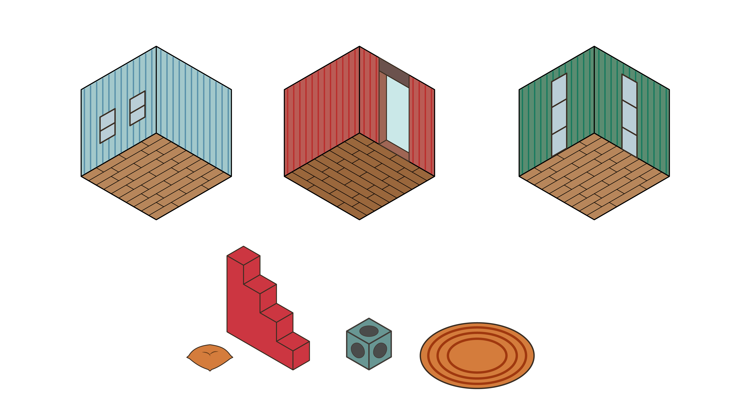
Concept art

Slide 13
Prototype

Slide 14
The end.
Questions?

